Slide 1
Discarded slides

Slide 2
Summary of physiology
Patients with hypercapnic respiratory failure generally have ‘frail’ respiratory systems with respect to CO2 homeostasis
There will be a larger increase in PaCO2 for the same absolute change in ventilation in patients with hypercapnia.
In UT, we catch this earlier due to elevation and SpO2 monitoring
Patients with hypercapnia are prone to recurrent exacerbations

Slide 3
Move physiology out of the front

Slide 4
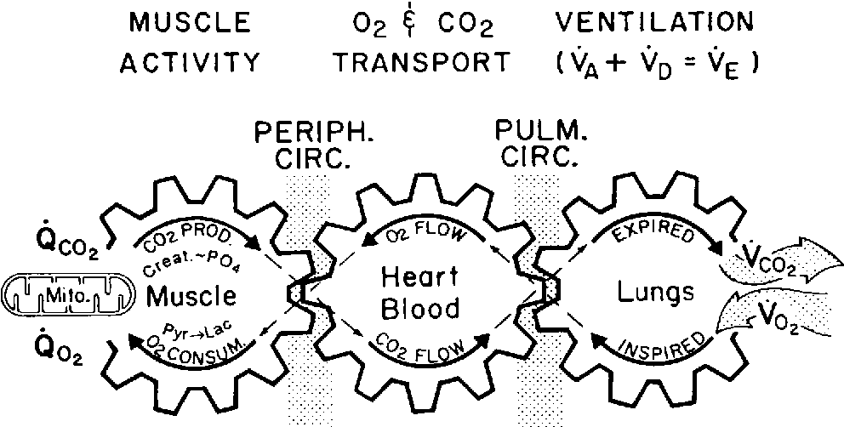
Hypercapnic Respiratory Failure
Definition: Higher PaCO2 in the blood than it should be
Cause: not enough alveolar ventilation for CO2 production
Near synonyms:
Ventilatory Failure
Type 2 Respiratory Failure
Hypoventilation
Hypercapnia
Except for REM sleep, our bodies keep PaCO2 within 3-5 mmHg despite huge changes in CO2 production
Build up here = CO2 in blood rises
Notes:
Hypercapnia Graphic
Wasserman, Karlman, et al. "Principles of exercise testing and interpretation." Journal of Cardiopulmonary Rehabilitation and Prevention 7.4 (1987): 189.

Slide 5
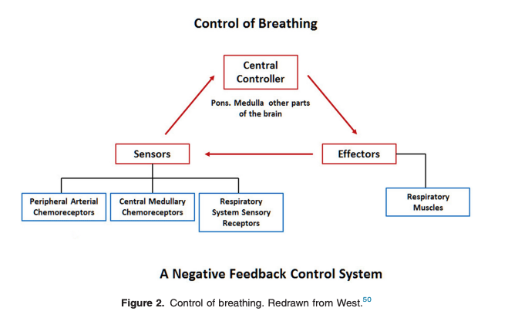
CO2 Homeostasis: Factors Causing Frailty
Decreased Drive to Breathe:
Opiates and other sedatives Brainstem lesions Compensated hypercapnia Sleep Metabolic alkalosis
High ventilatory need:
Increased CO2 Production | Increased Deadspace ‘Wasted Vent’ | Low desired PaCO2
Fever, Infection, or Inflammation Advanced malignancy Muscle activity Seizures Exercise ↑↑ Work of breathing Toxic ingestion Obesity | Anatomic shallow breathing Physiologic Pulmonary embolism Pulmonary hypertension Congestive heart failure Parenchymal lung disease of any kind | Metabolic acidosis Hypoxia
Unable to breathe:
Muscle weakness or inefficiency | Increased respiratory system loads
Neuromuscular disease Lung Hyperinflation Respiratory muscle hypoxia | Elevated airway resistance COPD, Asthma Mucus Upper-airway obstruction Stiff Lungs Parenchymal lung disease Pulmonary edema Stiff Chest Wall Pleural disease Excess or stiff chest wall tissue
Red = OHS, as an example
Notes:
Note: Frailty vs Size of physiologic disturbance.
“Homeostatic capacity” – depending on Ventilatory Reserve and metabolic milieu – a given level of frailty in the respiratory system may result in different levels of dysregulation.
Of note: OHS is a good example here where there are multiple factors in red

Slide 6
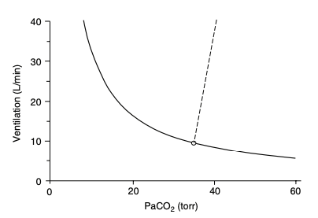
Predispositions to Exacerbations
Parabola assumes constant production of CO2 and efficiency of the lung
As Ventilation drops, each further drop causes proportionally more CO2 accumulation.
Analogous to creatinine & GFR
Notes:
Mathetmatically, this is the same reason why a sCr from 1->2 takes a large change in GFR, but from 5-6 is only a small change.
: Metabolic Parabola

Slide 7
Hypercapnia in SLC
P_{A}O₂ = FiO₂ (P_{B}-47)—(PaCO₂/R) → O₂ 17.8 mmHg lower at 4500ft
SpO2 is routinely obtained in clinical practice, PaCO2 (or TcCO2) is not
SLC → earlier identification
Notes:
Hypercapnia is largely iatrogenic: without supplemental oxygen, people with hypercapnia wouldn’t persist – especially if they had concomitant lung disease.
This also makes sense why these people might be so frail and prone to readmission… as your PaCO2 goes up, your buffer goes down. In fact, that’s probably why we’re evolved to hyperventilate with altitude. – called referred to as “ventilatory acclimatization” (92).
Lastly: PaCO2 increases exponentially as VE decreases linearly (think of CO2 clearance and how GFR is much more different th
SpO2 <90% catches people’s attention
Corresponds to a PaO2 of ~55 mmHg (depending exactly on the individual’s oxygen hemoglobin dissociation curve.
Normal A-a gradient? 4 + (0.25 * Age)
Critical PAO2 = paO2 + (Normal A-a gradient)
Critical PAO2 = 51 + 0.25 * Age
PA_{O2} = (P_{atm} – P_{H2O}) * Fi_{O2} – (Pa_{CO2} / RQ) + Fi_{O2} * Pa_{CO2} * (1-RQ)/RQ
PA_{O2} = (650 – 47) * 0.21 – (Pa_{CO2} / 0.8) + 0.21 * Pa_{CO2} * (1-0.8)/0.8
PA_{O2} = 126.63 – (Pa_{CO2} / 0.8) + 0.05 * Pa_{CO2}
PA_{O2} = 126.63 – 1.3 * Pa_{CO2}
At 4500 ft:
PaCO2 = 58.17 - 0.19 * Age
At seal Level:
PaCO2 = 75.95 – 0.19 * Age

Slide 8
Hypotheses: on first (physiologic) principles
Many will have the first time they manifest respiratory frailty during an exacerbation
This group will be at high risk for repeat exacerbations
Major source of morbidity, mortality, and cost to the system
Interventions to reduce frailty or physiologic stressors may reduce exacerbations
Better evidence is needed to support these practices to streamline payor funding
If many of these patients are missed during presentation, or proper management is not instituted, this is a lost opportunity.

Slide 9
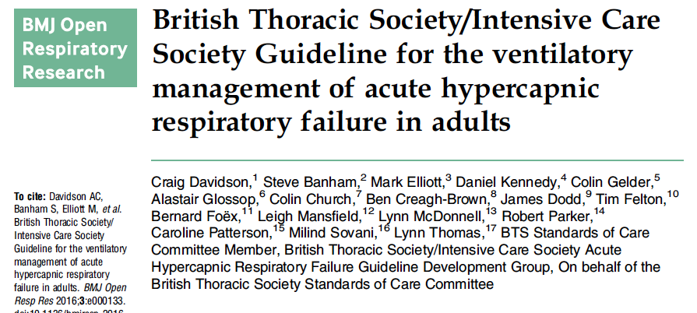
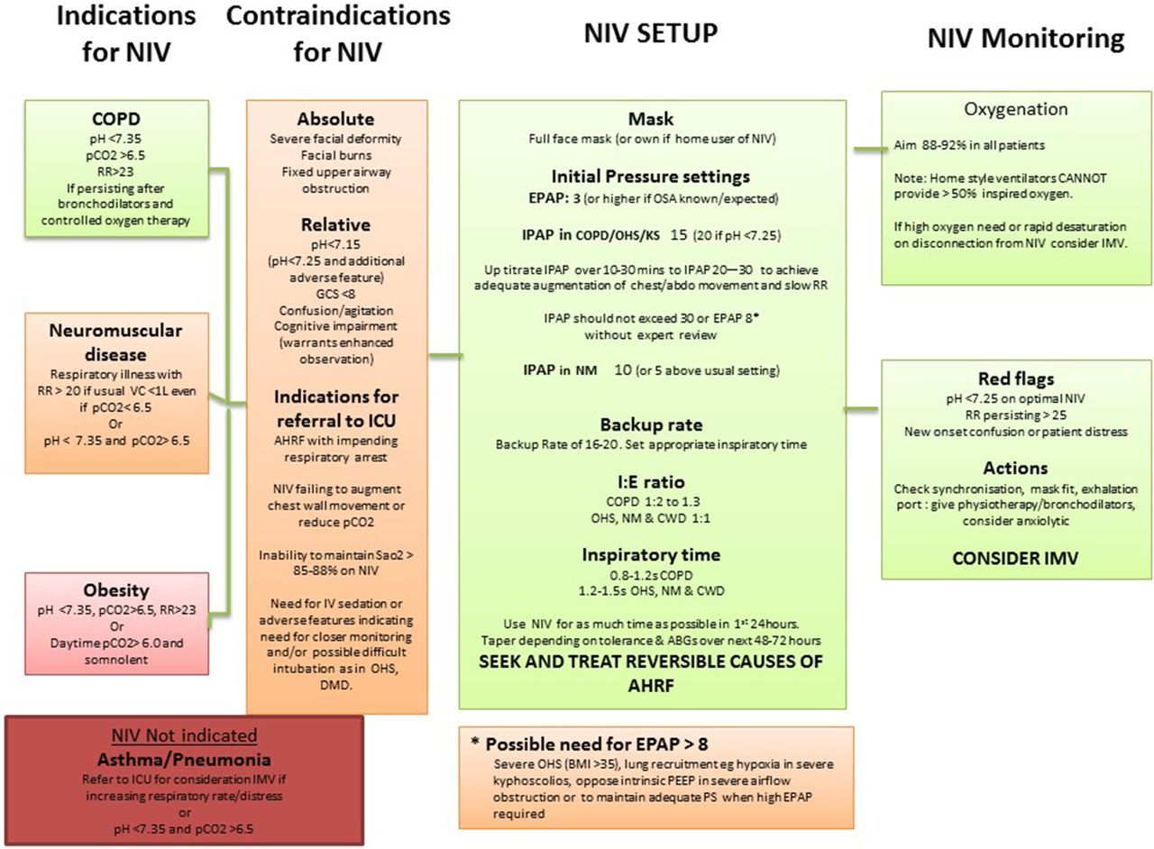
British Guideline

Slide 10
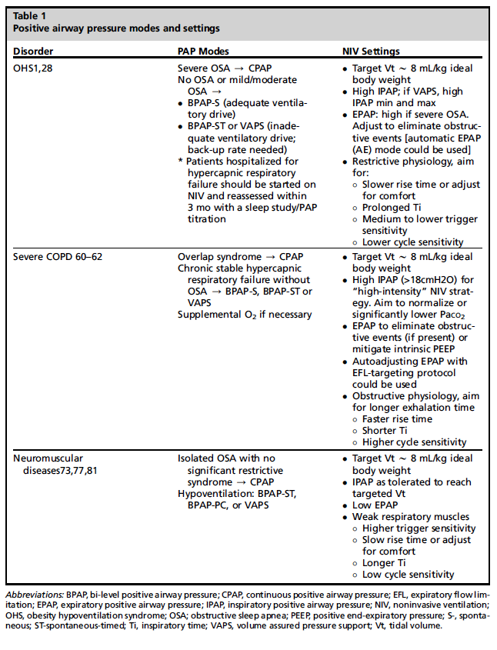
From https://www.sleep.theclinics.com/article/S1556-407X(22)00065-0/fulltext

Slide 11
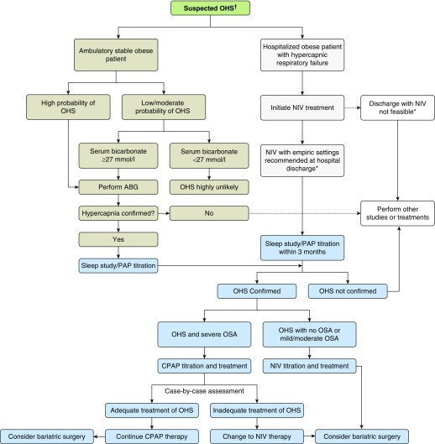
CHEST?
Note: the chest(?) algorithm has w/n 3 months.

Slide 12
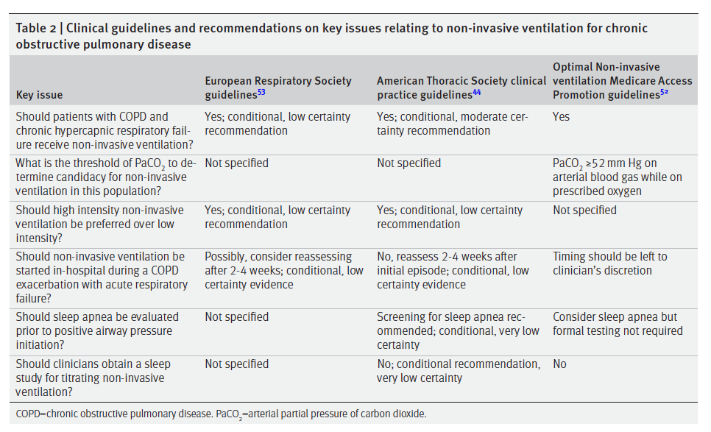
Notes:
“ research is needed into which patients (i.e., phenotypes) would be expected to benefit the most from NIV therapy”
2 week delay – predicting who will have chronic hypercapnia?
‘improved health-relatedquality of life, reduced sleep hypoventilation and improved daytime lung function‘ – ERS 2022 Review
In 2019, the Agency for Healthcare Research andQuality contracted for a technology assessment of NIVin the home. Based on a systematic review of theliterature, the task force concluded that for COPD,BPAP reduced dyspnea and mortality and increasedactivities of daily living, whereas both BPAP and HMVreduced hospitalizations
Wilson ME, Dobler CC, Morrow AS, et al. Association of home
noninvasive positive pressure ventilation with clinical outcomes in
chronic obstructive pulmonary disease: a systematic review and
meta-analysis. JAMA. 2020;323(5):455-465.
NIV – w use of backup rate and high driving pressure has been found helpful. Not used all that much in USA.
Köhnlein T, Windisch W, Köhler D, et al. Non-invasive positive pressure ventilation for the treatment of severe stable chronic obstructive pulmonary disease: a prospective, multicentre, randomised, controlled clinical trial. Lancet Respir Med. 2014;2(9):698–705. [PubMed] – NIV for severe stable COPD – RCT. Showing survival benefit at 1 year
Murphy in JAMA - https://jamanetwork.com/journals/jama/fullarticle/2627985 - similar findings with outcomes of admission free survival.
https://www.ncbi.nlm.nih.gov/pmc/articles/PMC6219270/ 240 COPD patients on chronic NIV: level of bicarbonate, high driving pressures, anxiety, and initiation after exacerbation predict CO2; Change in PaCO2 not associated with survival.
Meta-analysis - https://www.ncbi.nlm.nih.gov/pmc/articles/PMC7042860/

Slide 13
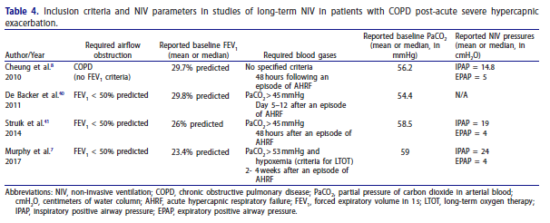

Slide 14
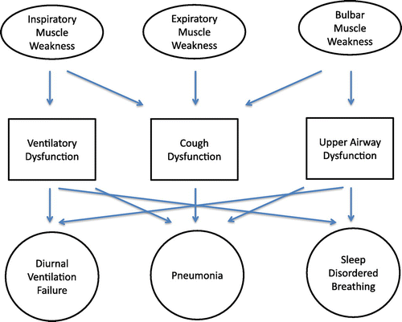
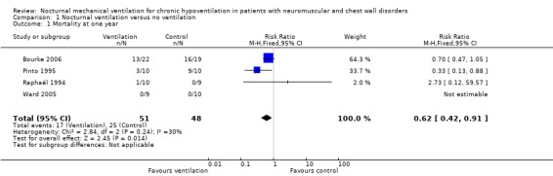
Neuromuscular/Restrictive Chest Wall: Hypercapnia Management
Included studies: 4 RCTs, n=173
RR of death: 0.62 (95CI 0.42 – 0.91)
Admission: 0.25 (95CI 0.08 – 0.82)
Very low level of (empiric) evidence
Notes:
[ ] add restrictive chest wall?

Slide 15
Neuromuscular hypoventilation
First occurs during REM sleep (lowest drive and muscle paralysis)- Base excess of 4 mEq correlates. - can be tested at home with ET CO2. For progressive conditions, often predates awake failure by years.
Can lead to blunted ventilatory responses in the day (perhaps predisposing to exacerbations, even beyond steady state failure)
NPPV likely improves survival in ALS
Unlikely to resolve after ‘acute presentation’
https://www.atsjournals.org/doi/10.1164/rccm.201210-1804CI

Slide 16
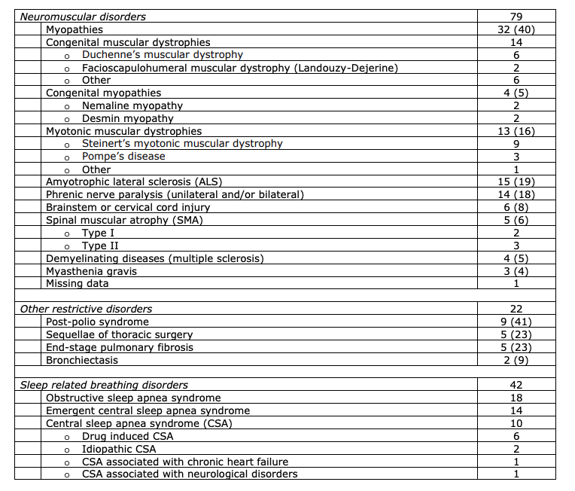
Neuromuscular disease
Corticospinal tracts connect resp centers to spinal motor neurons – ventilatory drive problems when abnormal.
MS – ventilation control problems and bulbar sx -> aspiration
SCI - https://breathe.ersjournals.com/content/12/4/328.short
ALS – NPPV suggested when FVC <50% pred, MIP < -60, SNIP less than 40, or sleep disordered breathing identified.
Dipharagmatic dsfxn – neuropathic, myopathic, or metabolic.
Duchenne/Becker/Myotonic Dystrophy – muscle weakness.
Graphic from: Geneva area NIV initation prev. CHEST
Notes:
https://journal.chestnet.org/cms/10.1016/j.chest.2020.02.064/attachment/b6c3b1f8-b826-4e55-8d6e-2255f6180fcb/mmc1.pdf

Slide 17
OIRD
the substantial variability in the observed respiratory effects of opioids in patients with OSA (61–64), where both harmful (62) and beneficial (63) effects on apnea severity during sleep have been demonstrated
Notes:
Image from CHEST 2016 150934-944DOI: (10.1016/j.chest.2016.05.022)
Finally, older sedatives—benzodiazepines and neuroleptics—are well-known respiratory depressants that can exacerbate chronic hypercapnia or cause acute-on-chronic hypercapnia in these patients. However, studies examining the impact of these medications on sleep apnea may have been confounded by concurrent use of continuous positive airway pressure, so no definitive conclusions can be drawn (30).
Mason M, Cates CJ, Smith I. Effects of opioid, hypnotic and sedating medications on sleep-disordered breathing in adults with obstructive sleep apnoea. Cochrane Database Syst Rev 2015;7:CD011090
From: https://journals.physiology.org/doi/pdf/10.1152/jn.00017.2021
One factor underlying variability in OIRD is that the respiratory response to opioids is state dependent. Opioid sensitivity is heightened during different neurological and physiological states including concurrent drug administration, such as anesthesia (8–10) and benzodiazepines (11), as well as sleep disordered breathing (SDB, Ref. 12). Indeed, SDB is prevalent among opioid users (13–15), and this clinical population is particularly vulnerable to OIRD since hypercapnic (16, 17) and hypoxic (18, 19) conditions present during SDB exaggerate opioid responses
12 Lam KK, Kunder S, Wong J, Doufas AG, Chung F. Obstructive sleep apnea, pain, and opioids: is the riddle solved? Curr Opin Anaesthesiol 29: 134–140, 2016. doi:10.1097/ACO.00000000000 00265.
16 Bailey PL, Lu JK, Pace NL, Orr JA, White JL, Hamber EA, Slawson MH, Crouch DJ, Rollins DE. Effects of intrathecal morphine on the ventilatory response to hypoxia. N Engl J Med 343: 1228–1234, 2000. doi:10.1056/NEJM200010263431705.
17 Potter JV, Moon RE. Commentaries on viewpoint: why do some patients stop breathing after taking narcotics? Ventilatory chemosensitivity as a predictor of opioid-induced respiratory depression. J Appl Physiol (1985) 119: 420–422, 2015. doi:10.1152/japplphysiol. 00034.2015.
Note Opiate-induced respiratory depression (OIRD) and OSA have an interesting relationship, varies by endotype: In support of this hypothesis is also the substantial variability in the observed respiratory effects of opioids in patients with OSA (61–64), where both harmful (62) and beneficial (63) effects on apnea severity during sleep have been demonstrated.
Finally, older sedatives—benzodiazepines and neuroleptics—are well-known respiratory depressants that can exacerbate chronic hypercapnia or cause acute-on-chronic hypercapnia in these patients. However, studies examining the impact of these medications on sleep apnea may have been confounded by concurrent use of continuous positive airway pressure, so no definitive conclusions can be drawn (30).
Mason M, Cates CJ, Smith I. Effects of opioid, hypnotic and sedating medications on sleep-disordered breathing in adults with obstructive sleep apnoea. Cochrane Database Syst Rev 2015;7:CD011090.

Slide 18
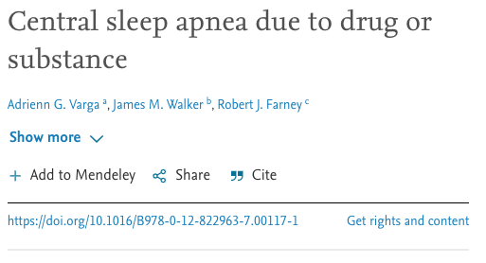
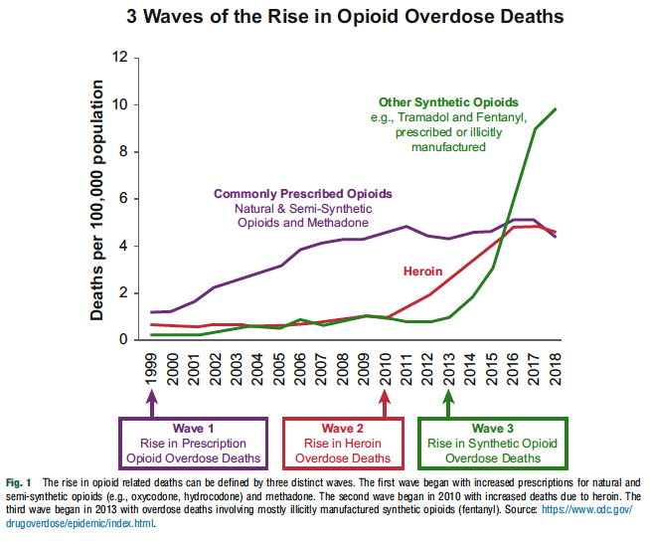
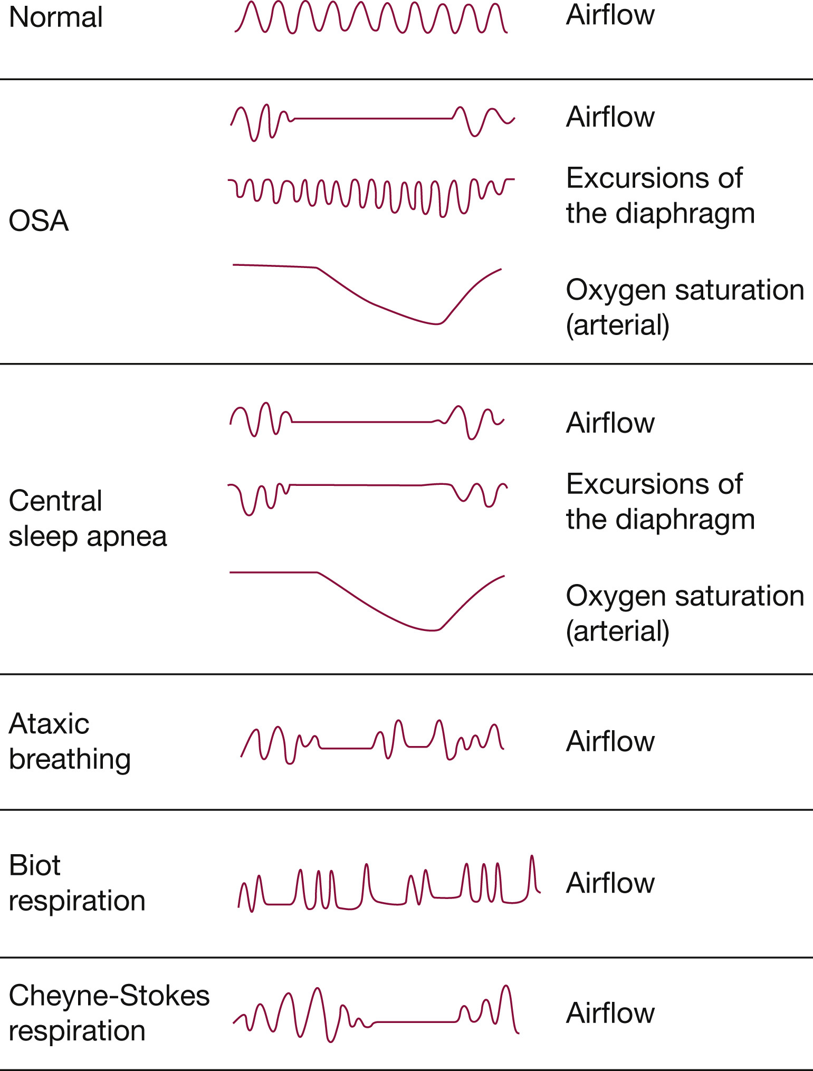
Opiates?
Respiratory pattern abnormalities:
- Frailty of the control center
Notes:
Manifestations of OIRD: breathing, ataxia, bradypnea ,central apneas, and hypoxemia
Thus, ‘hypoventilation’ is probably part of the abnormality, and part of the pathophysiology leading to adverse outcomes
Fatal apnea = ultimate cause of death; ataxia contributes or predates? (analogous to hyperkalemia)
Correa et al 2015
Accordingly, opioids can have a global effect and suppress
all parameters of respiration: breathing frequency, tidal volume, chest and abdominal wall compliance, upper airway patency,
cough reflex, and chemoresponses to hypercapnia and hypoxia
Pattinson
“OIRD, a term usually applied to the respiratory effects of acute opioid toxicity occurring in the perioperative environment, is
a potentially lethal state traditionally recognized by a constellation of properties including bradypnea, hypoxemia and sedation
(Macintyre et al., 2011; Montandon and Horner, 2019; Pattinson, 2008). Other established properties of OIRD that are not
routinely incorporated into clinical management are decreased ventilatory responses to hypoxia and hypercapnia, reduced chest
wall compliance, decreased hypoglossal nerve output, upper airway obstruction, obstructive apneas, central apneas and the presence
of ataxic breathing patterns (Hajiha et al., 2009; Phua et al., 2017; Weil et al., 1975).
“

Slide 19
PubMed: 31184503
https://www.atsjournals.org/doi/10.1513/AnnalsATS.201902-100OC
Conclusions: In adults admitted with acute heart failure and found to be at high risk of SDB, opiate use in the hospital was highly prevalent and was associated with a greater likelihood of escalation of care
Notes:
[ ] Opiates sleep Review article ARJCCM 2022

Slide 20
Pathogenesis of obstructive sleep apnea in individuals with the COPD + OSA Overlap syndrome versus OSA alone Physiological Reports. 2020;8:e14371. https://doi.org/10.14814/phy2.14371
OSA pathogenicity:
Anatomic factors: upper airway collapsibility (may stiffen when lung is hyper-inflated, but emphysema loss of elastic recoil may lessen this – hard to know a priori)
Neurologic / Physiologic factors: upper airway muscle response (worsened by ICS? Smoking?), respiratory-related arousability from sleep (may be lower in OVS due to frequent awakenings in the absence of upper airway collapse), control of breathing (respiratory drive generally increased)
Matched OSA (n=15) to OVS (n=15; most with moderate obstruction) on gender, age, BMI. Exclude: narcotics, sedatives, supp O2, recent exacerbation, BMI over 36, active smoking, heavy EtOH
PSG to determine Veupnea, Vpassive and Pcrit, Varousal/ArTh, Loop gain
“Consistent differences in key OSA traits were not observed between OVS and OSA alone.”. OVS: lower sleep efficiency, REM SpO2
Reduced upper airway response in those with air trapping; increased loop gain in those with worse airflow obstruction (contrary to expection; perhaps mediated by hypoxemia?). Somewhat lower arousal threshold – perhaps explains how hypercapnia can occur?
No difference in collapsibility: perhaps this is selection – if you have to have dx of OSA, then by definition the airway must be collapsable
Notes:
“
Veupnea: Ventilation during sleep in the absence of upper
airway obstruction (i.e., on therapeutic CPAP pressure),
such that ventilation should match baseline ventilatory
drive.
Vpassive and Pcrit: Both are measures of collapsibility of
the upper airway, determined at baseline ventilatory
drive (i.e., without accumulation of any additional drive
that might result from prolonged upper airway obstruction).
Vpassive measures ventilation at atmospheric pressure
(zero cm H2O) under such nonactivated airway
conditions, while Pcrit measures the pressure at which
inspiratory flow goes to zero under nonactivated airway
conditions.
Varousal and Ventilatory arousal threshold (ArTh): Both are
measures of the tendency to wake from sleep due to inspiratory
flow limitation. Varousal measures the minimum
ventilation that can be sustained without arousal during
steady-state conditions. Ventilatory drive accumulates
under such conditions, leading to increases in intrathoracic
pressure swings; a high Varousal indicates a tendency
to wake up with minimal increase in intrathoracic pressure
swings. The ArTh is a calculated value, using the LG and
Veupnea data to estimate the ventilatory drive that is present
at the ventilation measured by Varousal.
Vactive and Upper airway gain (UAG): Both are measures
of the ability of the upper airway to dilate in response to
increases in respiratory drive. Vactive measures ventilation
at atmospheric pressure (zero cm H2O) under maximally
tolerated increased respiratory drive (i.e., at the same
point in drive as Varousal and ArTh). The UAG is a calculated
value, using Vpassive, Vactive, Veupnea, and LG to determine
the increase (or decrease) in ventilation achieved
using an increase in respiratory drive.
Loop Gain (LG): Measures instability in ventilatory control,
by measuring the ratio of ventilatory response to a
steady-state ventilatory disturbance. The disturbance is
the increase in drive that results from steady-state inspiratory
flow limitation conditions, and response is determined
by suddenly alleviating the flow limitation.

Slide 21
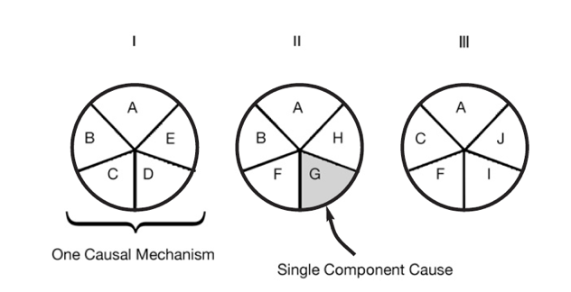
Sufficient-Component Cause Model
Sufficient cause: a set of factors that will cause disease when present
Component cause: a factor that, if not present, no disease would occur
Necessary cause: in all sufficient cause sets, this component must be present
3 Different Sufficient Causes
A = Necessary Cause
A – J = Component Cause
Notes:
Hypothesis
Rothman KJ. Am J Epidemiol 1976; 104: 587-592.
a sufficient cause as "...a complete causal mechanism" that "inevitably produces disease." Consequently, a "sufficient cause" is not a single factor, but a minimum set of factors and circumstances that, if present in a given individual, will produce the disease.

Slide 22
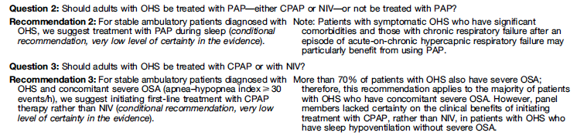
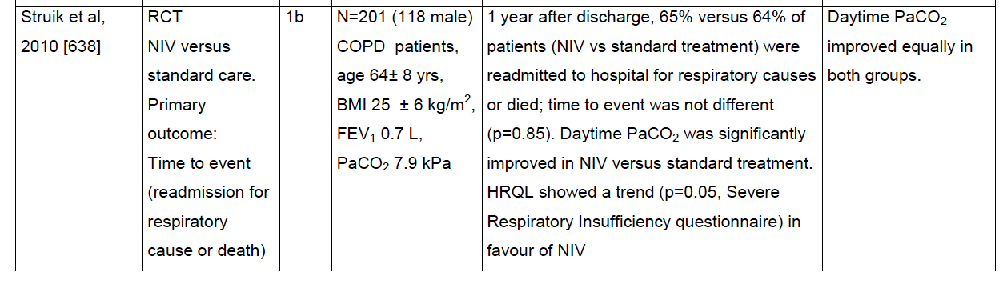
Resolution after exacerbation
“To date, no studies have directly examined the timing of resolution of hypercapnia after an acute exacerbation to determine optimal timing of initiation of long-term NIV: https://www.atsjournals.org/doi/full/10.1513/AnnalsATS.202009-1171AG . Could you send people out with capnography monitors (e.g. when they leave to the floor) to clarify this trajectory?

Slide 23
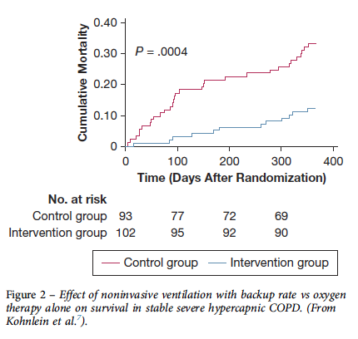
Kohnlein RCT
In 2014, Kohnlein et al7published a landmark prospective, multicenter, randomized controlled trial of BPAP ventilation compared with optimized standard therapy in patients with chronic stable hypercapnic COPD. Patients had stage IV COPD and a mean age of 64.4 years, with resting PaCO2$51.9 mm Hg and pH>7.35. BPAP ventilation was targeted to reduce baseline PaCO2by at least$20%, or to achieve values<48 mm Hg, using high inspiratory pressures and a backup rate. The difference in 1-year all-cause mortality was profound, with 12% in the BPAP group and 33% in the control group
Notes:
The effect of BPAP onoverall survival in patients with chronic hypercapnicCOPD was believed to be related to the use of a highinspiratory pressure and backup rate (termed high-intensity ventilation). The rationale for the backup rateis that it helps to sustain nocturnal ventilation in the faceof physiological suppression of respiratory drive duringsleep, which, combined with diaphragm dysfunctionrelated to hyperinflation, can lead to hypoventilationand failure to trigger, especially during rapid eyemovement sleep.
Another similarly designed study by Struik et al12found no significant differences in readmissions ormortality, although these patients did not manifestpersistent hypercapnia.
12. Struik FM, Sprooten RT, Kerstjens HA, et al. Nocturnal non-invasive
ventilation in COPD patients with prolonged hypercapnia after
ventilatory support for acute respiratory failure: a randomised,
controlled, parallel-group study. Thorax. 2014;69(9):826-834.

Slide 24
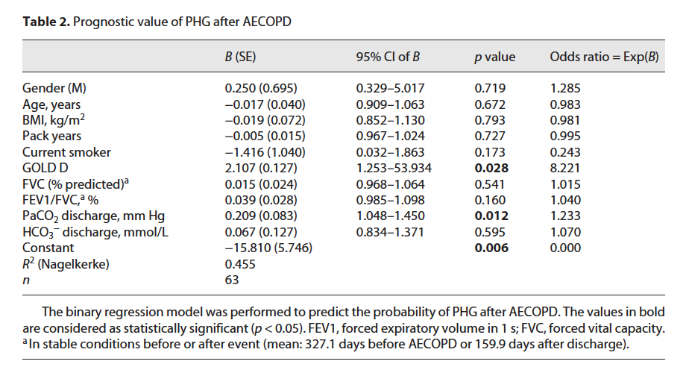
AECOPD+Hypercapnia: 40% return to eucapnia [ ] combine with prior
DOI: 10.1159/000524845 , Respiration 2022
Notes:
Up to 40% of patients w AECOPD and increased COPD revert to normal acid base, rest persist
NIV indicated in persistent
Factors predicting the development of
RHG were higher forced expiratory volume in 1 s (FEV1)
or absent Cor pulmonale [6–8].
Prior work: McNally – 40% had reversible hypercapnia, these patients had similar mortality risk to normocapnic. Persistent = elevated risk.
82 (of 143) inpatients with COPD and elevated CO2; Leipzig Germany
42 reverted to normal acid-base at median follow-up of 148 days, 40 persisted at follow-up – despite high majority (88%) being hypercapnic at discharge
Discharge PaCO2 (perhaps marker of severity of exacerbation) and Gold Stage D (vs other; perhaps marker of resp system frailty) independently predicted persistence of hypercapnia. Univeriate associations also included HCO3-, Base Excess (probably brewing)

Slide 25
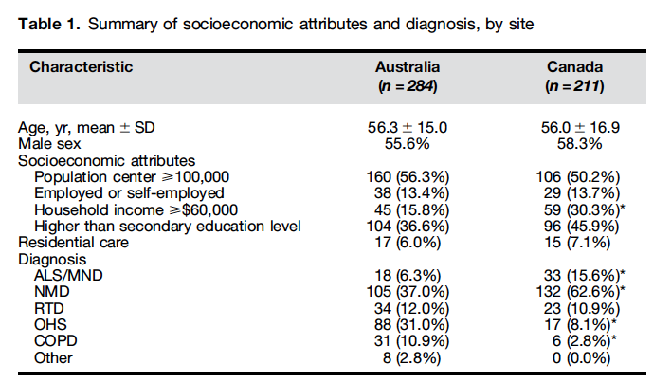
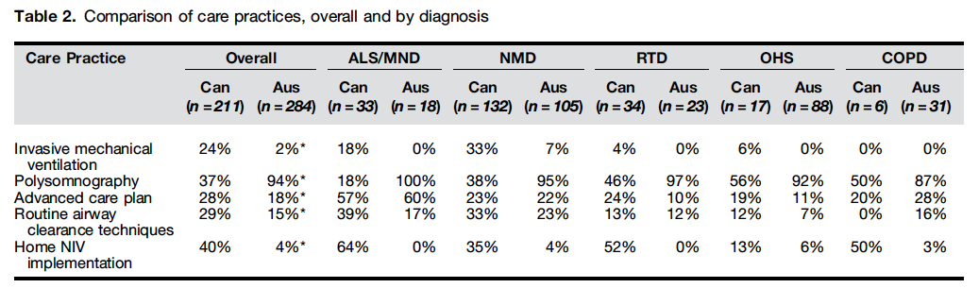
Variation in implementation
Notes:
DOI: 10.1513/AnnalsATS.201509-590OC
Victoria and BC populations, questioner
Canada: more likely IMV, home implementation of NIV
Austrilia: more likely had PSG
Wide range of clinician behavior note, also in citation 1

Slide 26
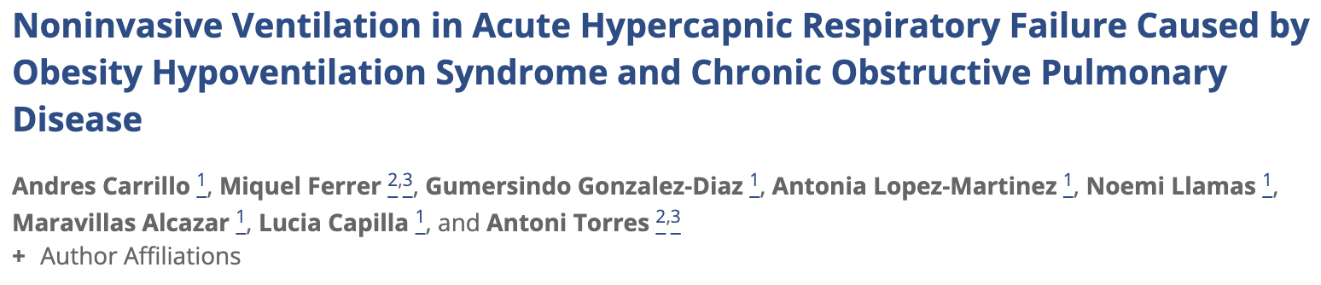
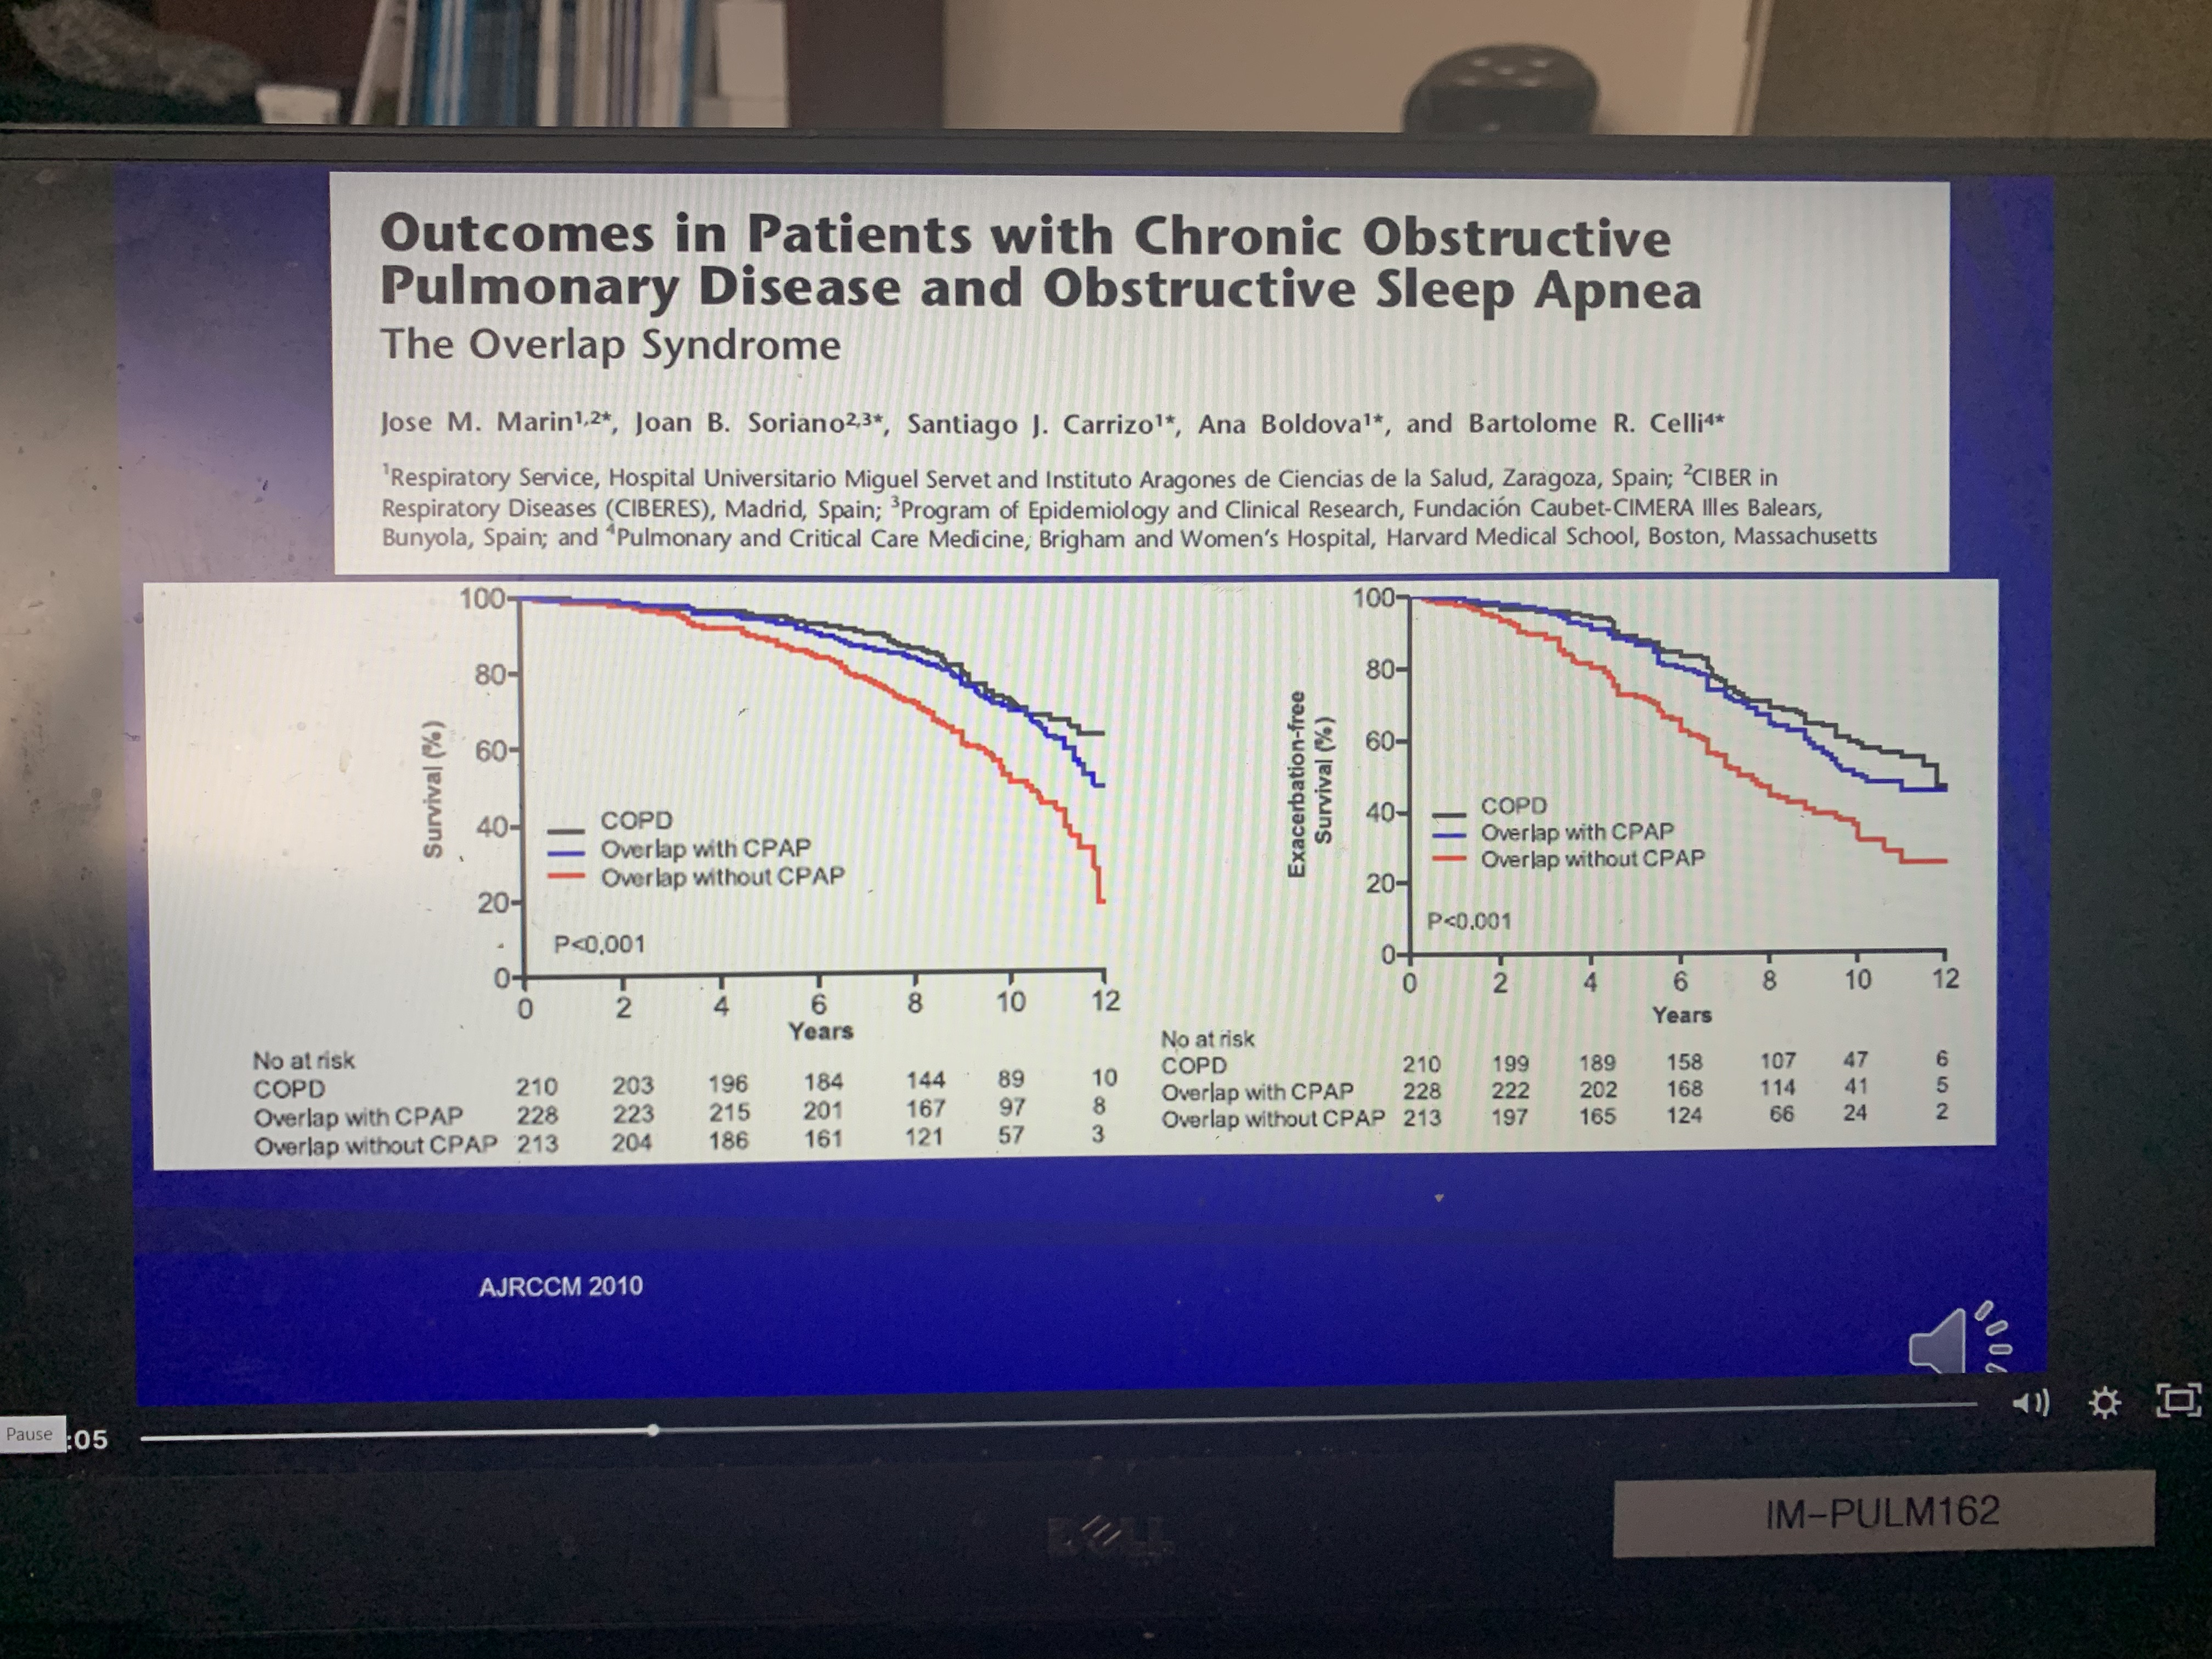
Single institution, Spain. Patients with COPD or OSA, pH <7.35 & PaCO2 > 45 mmHg,
Notes:
Carrillo A, Ferrer M, Gonzalez-Diaz G, Lopez-Martinez A, Llamas N, Alcazar M, Capilla L, Torres A. Noninvasive ventilation in acute hypercapnic respiratory failure caused by obesity hypoventilation syndrome and chronic obstructive pulmonary disease. Am J Respir Crit Care Med 2012;186:1279–1285
Hospital survivors were followed for 1 year to assess hospital readmission rate and survival.
- , both 1-year adjusted survival and readmission rate following AHRF were similar to that of patients with COPD.
- only 55% of patients with OHS studied were put on a long-term positive pressure ventilatory support (CPAP or NIV) at home, and a very low 10% were treated by NIV
- suggests that long-term NIV should be systematically proposed at home after an acute-on-chronic failure in patients with OHS. Oxygen therapy alone is not appropriate when taking into account the underlying mechanisms for hypoventilation in OHS (15) but remains overused as demonstrated by the 39% of patients with OHS on long-term oxygen therapy before their admission for ARHF in the study by Carrillo and colleagues.
-interesting side note: RR and pH was same between OHS and COPD group in this study.
-50% readmission rate in 1 year in both OHS and COPD group
“Despite its established severity compared with eucapnic obesity, OHS is largely underrecognized, with only one-third of patients actually diagnosed when hospitalized for acute-on-chronic respiratory failure (3–6).” “Patients in whom NIV is initiated in acute conditions are more likely to have developed OHS-related cardiovascular complications, thus increasing the risk of multiple organ failure and death at the time of acute respiratory failure (5, 6)”
3. BaHammam A, Syed S, Al-Mughairy A. Sleep-related breathing disorders in obese patients presenting with acute respiratory failure. Respir Med 2005;99: 718–725.
4. Nowbar S, Burkart KM, Gonzales R, Fedorowicz A, Gozansky WS, Gaudio JC, Taylor MR, Zwillich CW. Obesity-associated hypoventilation in hospitalized patients: prevalence, effects, and outcome. Am J Med 2004;116:1–7.
(Nowbar: Of 277 patients with a BMI ≥35 kg/m² admitted to an inpatient medical service, Nowbar and colleagues⁴ found that 31% met criteria for OHS. when a subgroup of patients with BMI greater than 50 kg/m² was examined, OHS was found in 48%. Of particular concern, (though likely representative of many hospitals), effective therapy for hypoventilation was only instituted in 13% of these patients.)
5. Pérez de Llano LA, Golpe R, Ortiz Piquer M, Veres Racamonde A, Vazquez Caruncho M, Caballero Muinelos O, Alvarez Carro C. Short-term and long-term effects of nasal intermittent positive pressure ventilation in patients with obesity-hypoventilation syndrome. Chest 2005;128:587–594.
6. Priou P, Hamel JF, Person C, Meslier N, Racineux JL, Urban T, Gagnadoux F. Long-term outcome of noninvasive positive pressure ventilation for obesity hypoventilation syndrome. Chest 2010;138:84–90.
Lancet 2018 – CPAP vs NIV: no difference.
However, Thorax trial showed quicker normalization and LV structural parameters.

